Slide 1
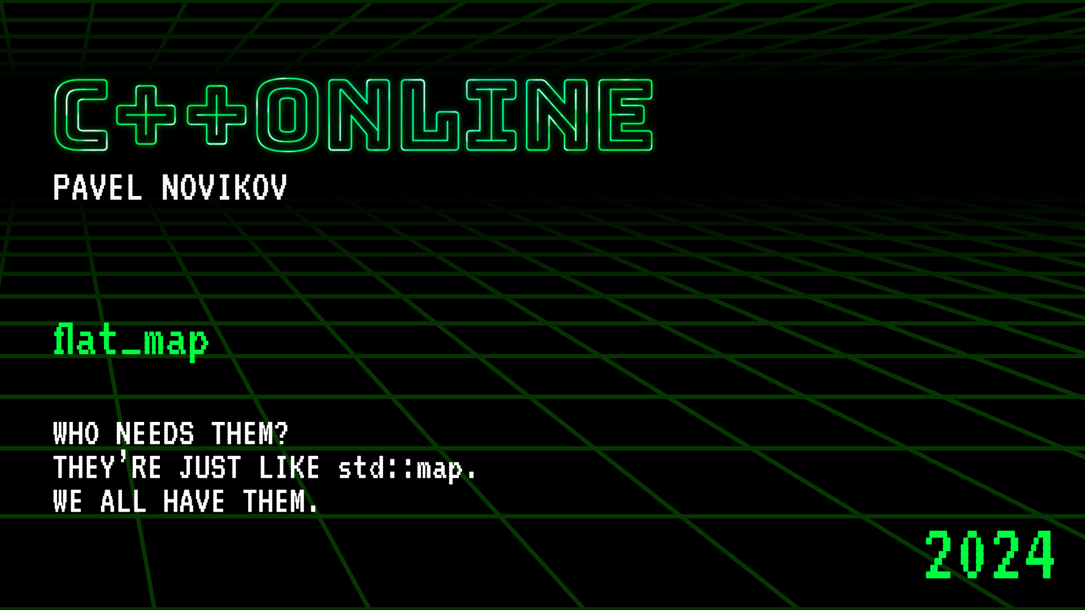

Slide 2


flat_map Who needs them? They're just like std::map. We all have them.
Pavel Novikov
@cpp_ape

Slide 3
You will learn
a refresher for the standard associative containers and when to use them
what is flat map and when to use it
Boost flat_map and std::flat_map + performance comparison with standard associative containers
what else can we do with flat map?

Slide 4
Standard associative containers
std::vector<std::pair<int, std::string>> getItems();
std::unordered_map<int, std::string> getItems();
std::map<int, std::string> getItems();
flat_map<int, std::string> getItems();
non-unique "keys"
unordered (w.r.t. "keys")
unique keys
unordered
unique keys
ordered

Slide 5
std::vector<std::pair<int, std::string>>
allocated memory
Complexity:
search | linear O(N)
element insertion/removal | linear O(N)
element insertion at the end | amortized constant O(1)

Slide 6
Standard associative containers
std::unordered_map<Key, Value, std::hash<Key>, std::equal_to<Key>>
bucket
bucket
bucket
node
node
node
node
node
node
Complexity:
search | constant O(1) on average
element insertion/removal | constant O(1) on average

Slide 7
Standard associative containers
std::map<Key, Value, std::less<Key>>
node
node
node
node
Complexity:
search | logarithic O(log N)
element insertion/removal | logarithic O(log N)

Slide 8
Flat map associative container
flat_map<Key, Value, std::less<Key>>
usually adapts vector-like container
allocated memory
Complexity:
search | logarithic O(log N)
element insertion/removal | linear O(N)

Slide 9
Let’s make a flat map
template<
typename Key,
typename Value,
typename Compare = std::less<Key>,
typename Container =
std::vector<std::pair<Key, Value>>
>
class FlatMap;

Slide 10
template<typename Key,
typename Value,
typename Compare,
typename Container>
class FlatMap : private Compare {
Container container;
public:
using key_type = Key;
using mapped_type = Value;
using value_type = std::pair<const key_type, mapped_type>;
using key_compare = Compare;
//...
for empty base optimization

Slide 11
Let’s make a flat map
template<typename Key,
typename Value,
typename Compare,
typename Container>
class FlatMap : private Compare {
//...
using reference =
std::pair<const key_type&, mapped_type&>;
using const_reference =
std::pair<const key_type&, const mapped_type&>;
//...

Slide 12
Let’s make a flat map
template<typename Key,
typename Value,
typename Compare,
typename Container>
class FlatMap : private Compare {
//...
using size_type = size_t;
using difference_type = ptrdiff_t;
//...

Slide 13
template<typename Key,
typename Value,
typename Compare,
typename Container>
class FlatMap : private Compare {
//...
using iterator =
Iterator<const Key, Value,
typename Container::iterator>;
using const_iterator =
Iterator<const Key, const Value,
typename Container::const_iterator>;
//...

Slide 14
Let’s make a flat map
template<typename Key,
typename Value,
typename Compare,
typename Container>
class FlatMap : private Compare {
//...
using reverse_iterator =
std::reverse_iterator<iterator>;
using const_reverse_iterator =
std::reverse_iterator<const_iterator>;
using container_type = Container;
//...

Slide 15
Let’s make a flat map
template<typename Key,
typename Value,
typename Compare,
typename Container>
class FlatMap : private Compare {
//...
FlatMap() = default;
size_t size() const { return container.size(); }
//...

Slide 16
template<typename Key,
typename Value,
typename Compare,
typename Container>
class FlatMap : private Compare {
//...
iterator begin() {
return iterator{ container.begin() };
}
const_iterator begin() const {
return const_iterator{ container.begin() };
}
const_iterator cbegin() const { return begin(); }
//...

Slide 17
template<typename Key,
typename Value,
typename Compare,
typename Container>
class FlatMap : private Compare {
//...
iterator end() {
return iterator{ container.end() };
}
const_iterator end() const {
return const_iterator{ container.end() };
}
const_iterator cend() const { return end(); }
//...

Slide 18
Let’s make a flat map
iterator find(const Key &key) {
const auto predicate = makePredicate();
auto needle = findNeedle(key, predicate);
// key < *needle
if (needle == container.end() or predicate(key, *needle))
return end();
return iterator{ needle };
}
const_iterator find(const Key &key) const {
return const_iterator{ const_cast<FlatMap*>(this)->find(key).i };
}

Slide 19
Let’s make a flat map
auto findNeedle(const Key &key, const Predicate &predicate) {
return std::lower_bound(container.begin(),
container.end(),
key,
predicate);
}
std::lower_bound() finds "first element not before"* key
*comment in MSVC standard library source code
binary search
elements "before" key
first element "not before" key

Slide 20
struct Predicate {
explicit Predicate(const Compare &comp) : comp{ comp } {}
auto operator()(const Key &a, const Key &b) const {
return comp(a, b);
}
auto operator()(const Key &a, const typename Container::value_type &b) const {
return comp(a, b.first);
}
auto operator()(const typename Container::value_type &a, const Key &b) const {
return comp(a.first, b);
}
auto operator()(const typename Container::value_type &a,
const typename Container::value_type &b) const {
return comp(a.first, b.first);
}
const Compare &comp;
};
Predicate makePredicate() {
return Predicate{ *static_cast<Compare*>(this) };
}

Slide 21
Let’s make a flat map
iterator find(const Key &key) {
const auto predicate = makePredicate();
const auto needle = findNeedle(key, predicate);
// key < *needle
if (needle == container.end() or predicate(key, *needle))
return end();
return iterator{ needle };
}
const_iterator find(const Key &key) const {
return const_iterator{ const_cast<FlatMap*>(this)->find(key).i };
}
needle is not before key
key is before needle
key and needle are not equivalent
needle is not before key
key is not before needle
key and needle are equivalent

Slide 22
Let’s make a flat map
iterator find(const Key &key) {
const auto predicate = makePredicate();
const auto needle = findNeedle(key, predicate);
// key < *needle
if (needle == container.end() or predicate(key, *needle))
return end();
return iterator{ needle };
}

Slide 23
Let’s make a flat map
std::pair<iterator, bool> insert(const value_type &value) {
const auto &key = value.first;
const auto predicate = makePredicate();
const auto needle = findNeedle(key, predicate);
// key < *needle
if (needle == container.end() or predicate(key, *needle))
return { iterator{ container.insert(needle, value) }, true };
return { iterator{ needle }, false };
}

Slide 24
Let’s make a flat map
std::pair<iterator, bool> insert(value_type &&value) {
const auto &key = value.first;
const auto predicate = makePredicate();
const auto needle = findNeedle(key, predicate);
// key < *needle
if (needle == container.end() or predicate(key, *needle))
return { iterator{ container.insert(needle, std::move(value)) },
true };
return { iterator{ needle }, false };
}

Slide 25
Let’s make a flat map
iterator find(const Key &key) {
const auto predicate = makePredicate();
const auto needle = findNeedle(key, predicate);
// key < *needle
if (needle == container.end() or predicate(key, *needle))
return end();
return iterator{ needle };
}

Slide 26
Let’s make a flat map
mapped_type &operator[](const Key &key) {
const auto predicate = makePredicate();
const auto needle = findNeedle(key, predicate);
// key < *needle
if (needle == container.end() or predicate(key, *needle))
return container.emplace(needle,
std::piecewise_construct,
std::forward_as_tuple(key),
std::tuple<>())->second;
return needle->second;
}
this behavior is required by the C++ standard
template<class... Args1, class... Args2> pair(std::piecewise_construct_t, std::tuple<Args1...> first_args, std::tuple<Args2...> second_args);

Slide 27
Let’s make a flat map
auto map = FlatMap<int, int>{};
map[1] = 23;
map.insert(std::pair{ 2, 42 });
const auto v = std::pair{ 3, 9000 };
map.insert(v);
for (const auto &[key, value] : map)
std::cout << key << "\t" << value << '\n';

Slide 28
Let’s make a flat map
for (const auto &[key, value] : map)
std::cout << key << "\t" << value << '\n';
auto &&__range = map;
auto __begin = __range.begin();
auto __end = __range.end();
for (; __begin != __end; ++__begin) {
const auto &[key, value] = *__begin;
// loop-statement
}

Slide 29
template<typename K, typename V, typename I>
struct Iterator {
explicit Iterator(I i) : i{ std::move(i) } {}
Iterator &operator++() { ++i; return *this; }
std::pair<K&, V&> operator*() const { return { i->first, i->second }; }
friend auto operator<=>(const Iterator&, const Iterator&) = default;
private:
I i;
template<typename, typename, typename, typename> friend class FlatMap;
};
using iterator = Iterator<const Key, Value,
typename Container::iterator>;
using const_iterator = Iterator<const Key, const Value,
typename Container::const_iterator>;

Slide 30
The iterator nuance
template<typename K, typename V, typename I>
struct Iterator {
//...
std::pair<K&, V&> operator*() const;
//...
};
auto map = FlatMap<int, int>{};
//...
*map.begin();
returns
std::pair<const int&, int&>
not a reference!

Slide 31
The iterator nuance
template<
typename Key,
typename Value,
typename Compare = std::less<Key>,
typename Container =
std::vector<std::pair<Key, Value>>
>
class FlatMap;
//...
using value_type = std::pair<const key_type, mapped_type>;
//...

Slide 32

auto map = boost::container::flat_map<int, int>{};
//...
typedef typename sequence_type::iterator iterator;
typedef typename sequence_type::const_iterator const_iterator;
//...
template <class Key
,class T
,class Compare = std::less<Key>
,class Allocator = void >
class flat_map;
ONE DOES NOT SIMPLY
KNOW THE CONTAINER TYPE

Slide 33
The iterator nuance
auto map = boost::container::flat_map<int, int>{};
boost::container::vector<std::pair<int, int>>
//...
typedef std::pair<Key, T> value_type;
//...
*map.begin();
int
int
returns
std::pair<int, int>& meh…

Slide 34
The iterator nuance
auto map = boost::container::flat_map<const int, int>{};
boost::container::vector<std::pair<const int, int>>
//...
typedef std::pair<Key, T> value_type;
//...
*map.begin();
const int
int
returns
std::pair<const int, int>&

Slide 35
The iterator nuance
auto map = FlatMap<int, int>{};
std::vector<std::pair<int, int>>
//...
using value_type = std::pair<const key_type, mapped_type>;
//...
*map.begin();
returns
std::pair<const int&, int&>

Slide 36
The iterator nuance
for (const auto &[key, value] : map)
std::cout << key << "\t" << value << '\n';
auto &&__range = map;
auto __begin = __range.begin();
auto __end = __range.end();
for (; __begin != __end; ++__begin) {
const auto &[key, value] = *__begin;
// loop-statement
}
returns
std::pair<const int&, int&>

Slide 37
The iterator nuance
for (auto &[key, value] : map)
std::cout << key << "\t" << value << '\n';
auto &&__range = map;
auto __begin = __range.begin();
auto __end = __range.end();
for (; __begin != __end; ++__begin) {
auto &[key, value] = *__begin; // does not work
// loop-statement
}
returns
std::pair<const int&, int&>

Slide 38
The iterator nuance
std::vector v1 = { 1, 2, 3 };
std::vector v2 = { 23, 42, 9000 };
// does not work
for (auto &[a, b] : std::views::zip(v1, v2))
b *= ++a;
*std::views::zip(v1, v2).begin();
returns
std::tuple<int&, int&>

Slide 39
The iterator nuance
Recommendation:
for (auto &&v : range)
// loop body
// works
for (auto &&[a, b] : std::views::zip(v1, v2))
b *= ++a;

Slide 40
The iterator nuance
for (auto &&[key, value] : map)
std::cout << key << "\t" << value << '\n';
auto &&__range = map;
auto __begin = __range.begin();
auto __end = __range.end();
for (; __begin != __end; ++__begin) {
auto &&[key, value] = *__begin; // works
// loop-statement
}
returns
std::pair<const int&, int&>

Slide 41
The iterator nuance
auto map = FlatMap<int, int>{};
//...
for (const auto &[key, value] : map)
std::cout << key << "\t" << value << '\n';
for ( auto &&[key, value] : map) {
// can modify 'value', but not 'key'
++value;
}

Slide 42
The iterator nuance
namespace std {
template<
class Key,
class T,
class Compare = less<Key>,
class KeyContainer = vector<Key>,
class MappedContainer = vector<T>>
class flat_map;
}
P0429 A Standard flat_map by Zach Laine

Slide 43
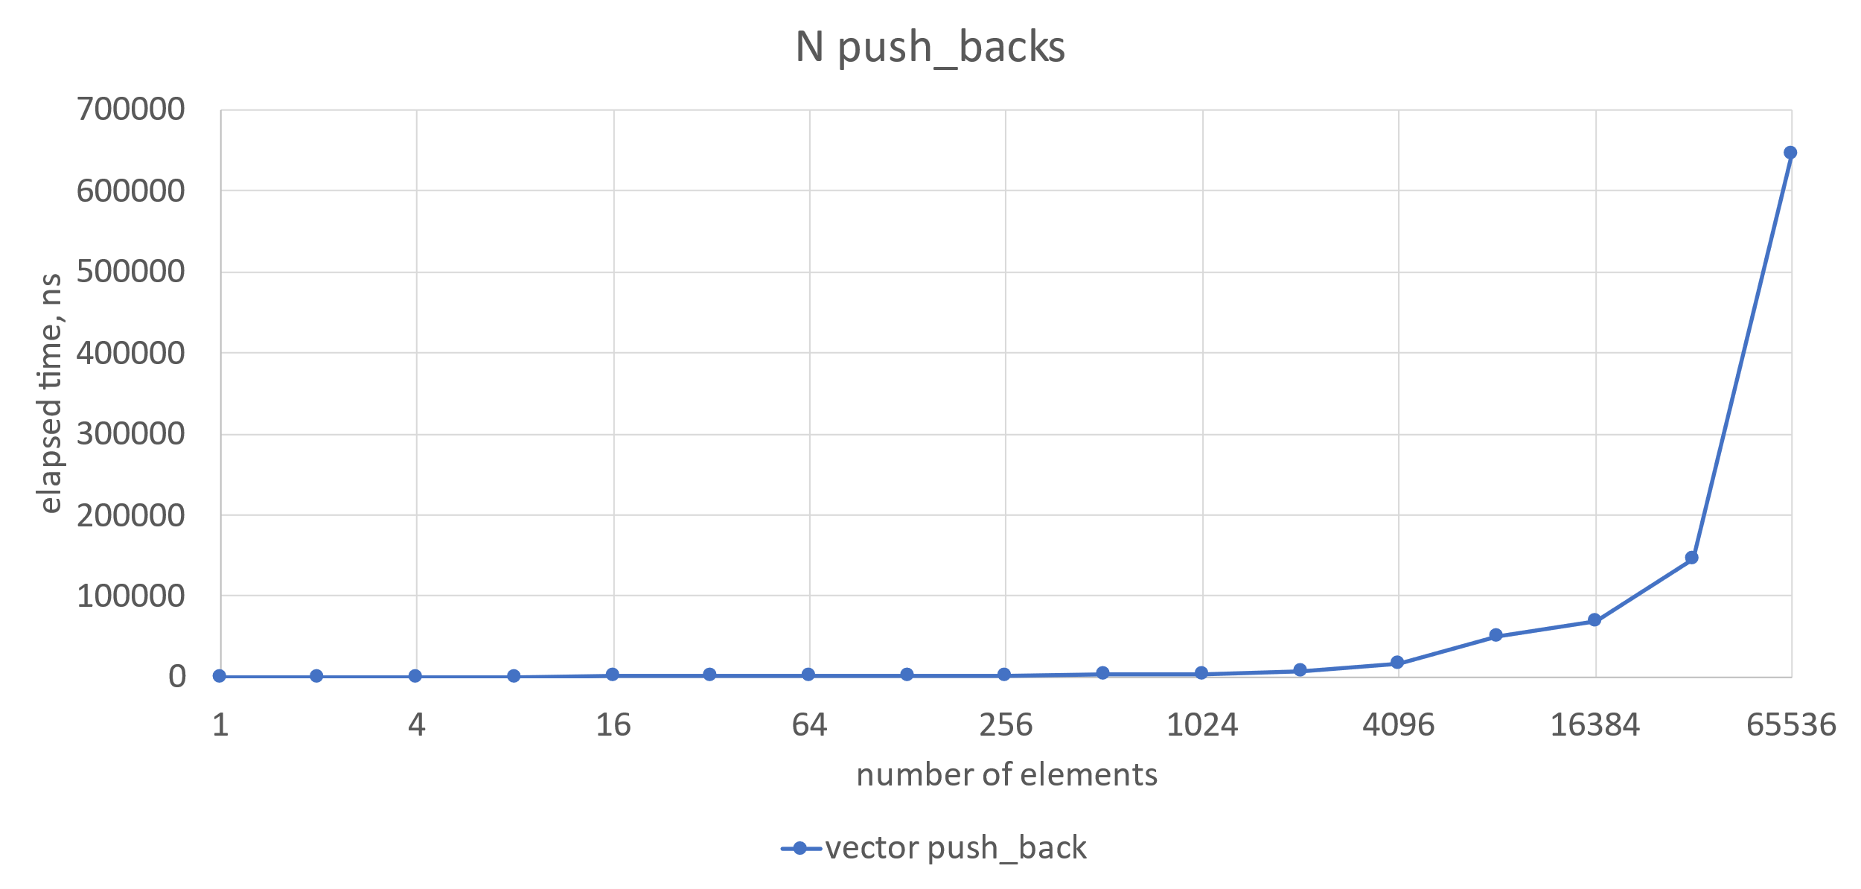
Benchmarking

Slide 44
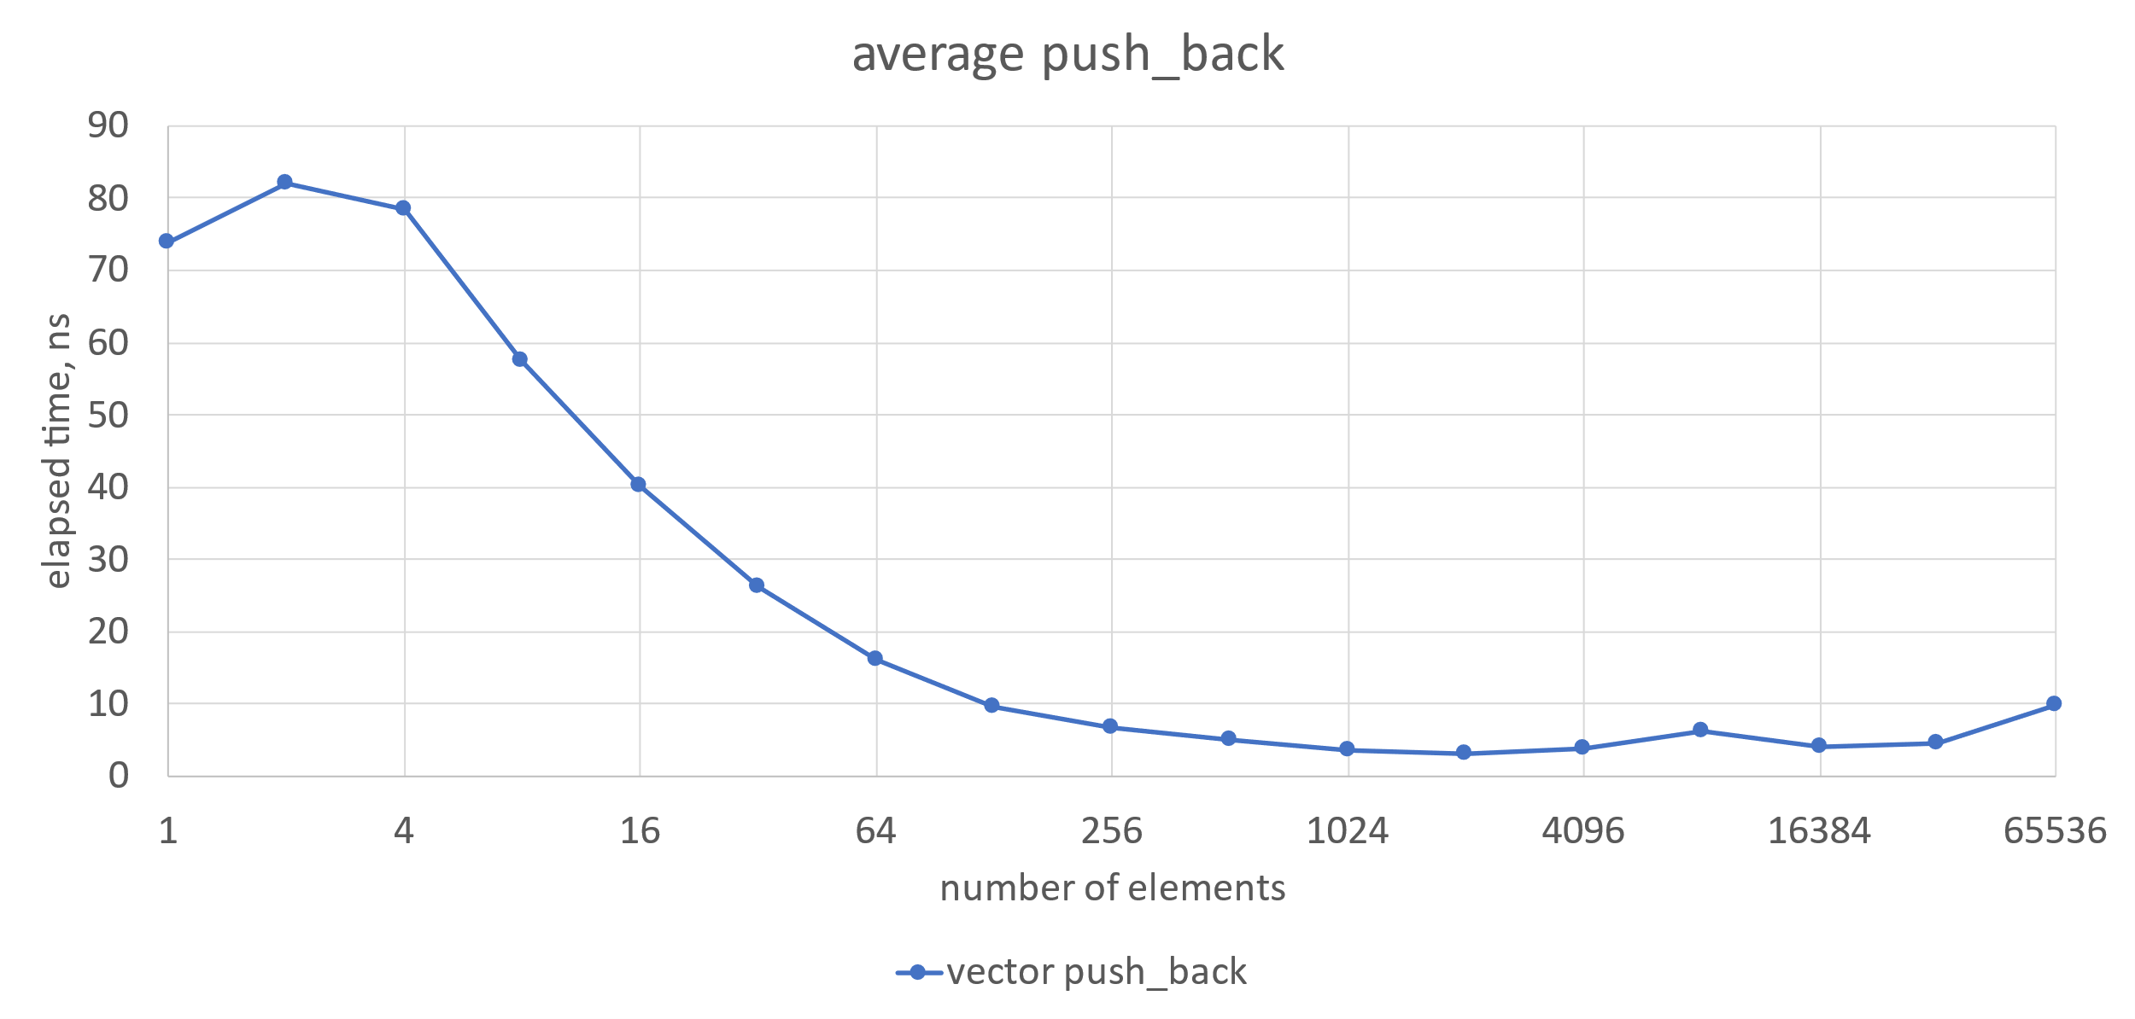
Benchmarking

Slide 45
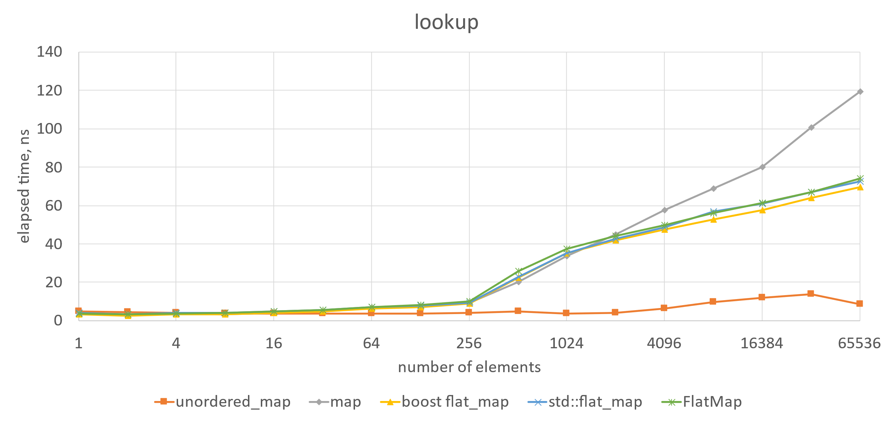
Benchmarking
std::map is slow for large N
std::unordered_map is the fastest for large N

Slide 46
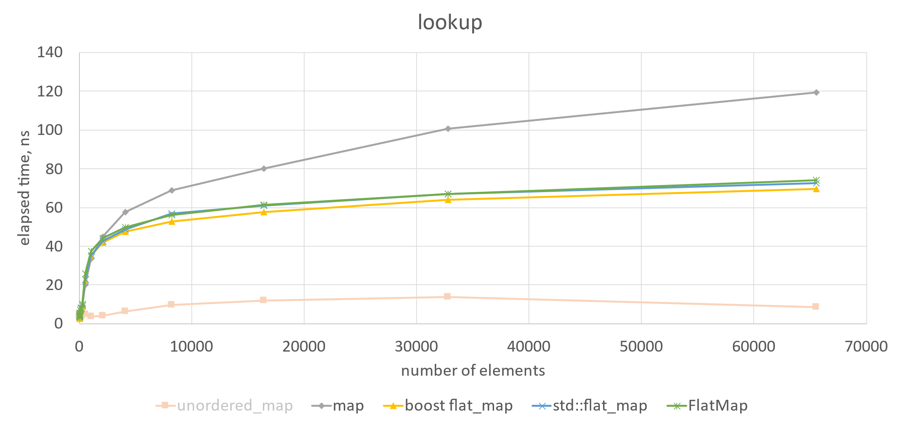
Benchmarking

Slide 47
Benchmarking
std::map is slow for large N
std::unordered_map is the fastest for large N

Slide 48
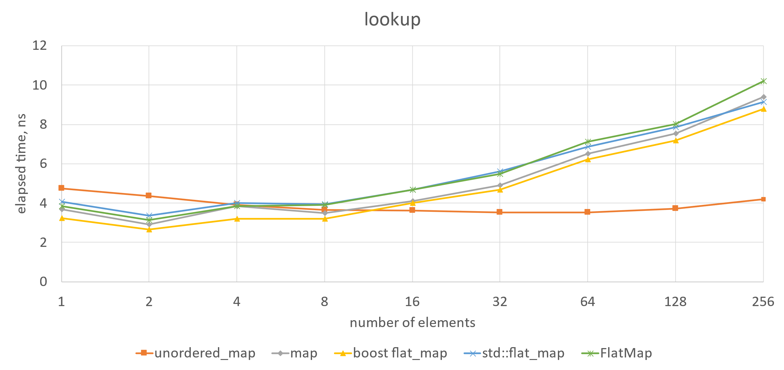
Benchmarking

Slide 49
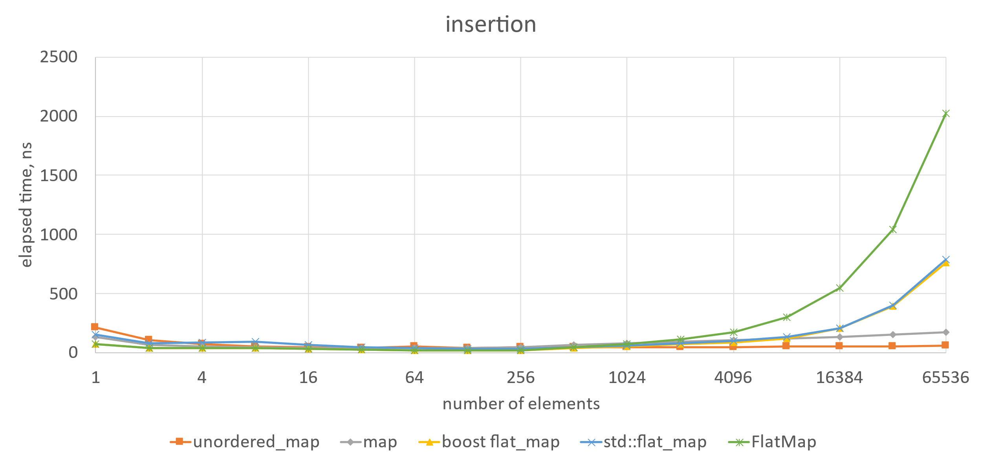
Benchmarking
flat maps are very slow for large N

Slide 50
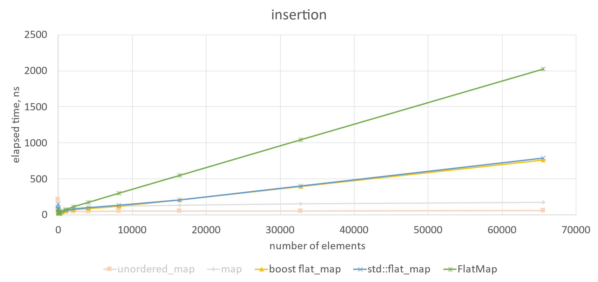
Benchmarking

Slide 51
Benchmarking
flat maps are very slow for large N

Slide 52
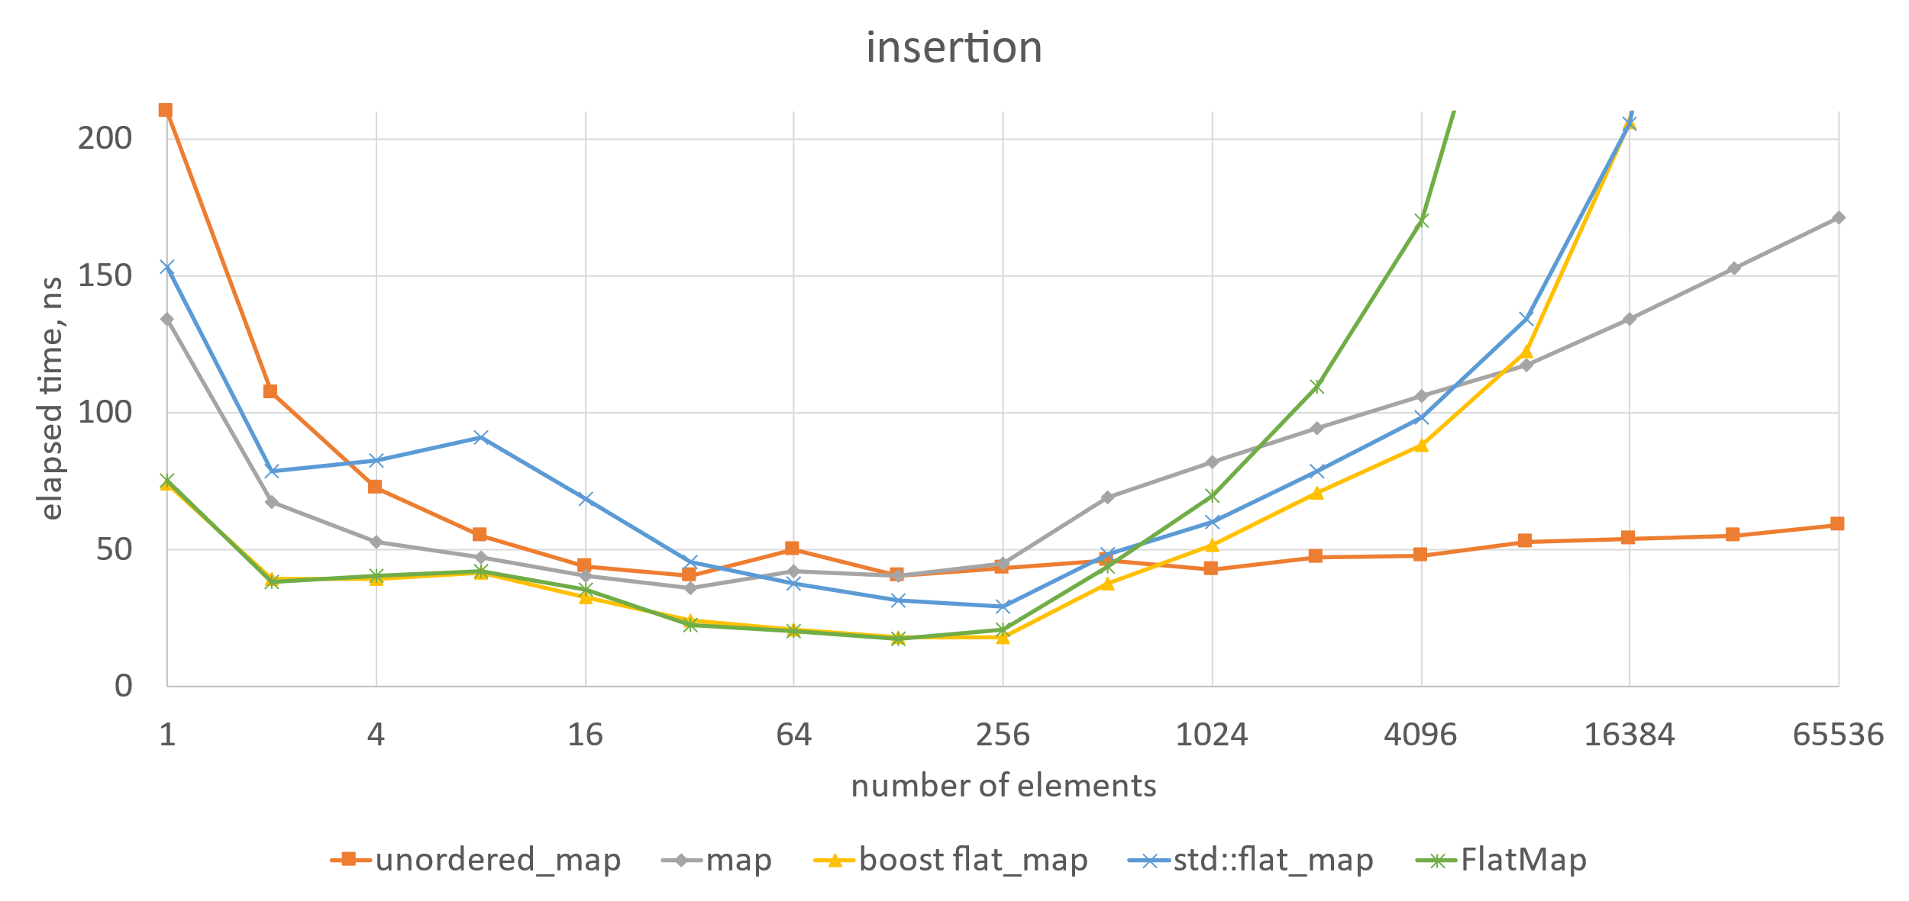
Benchmarking

Slide 53
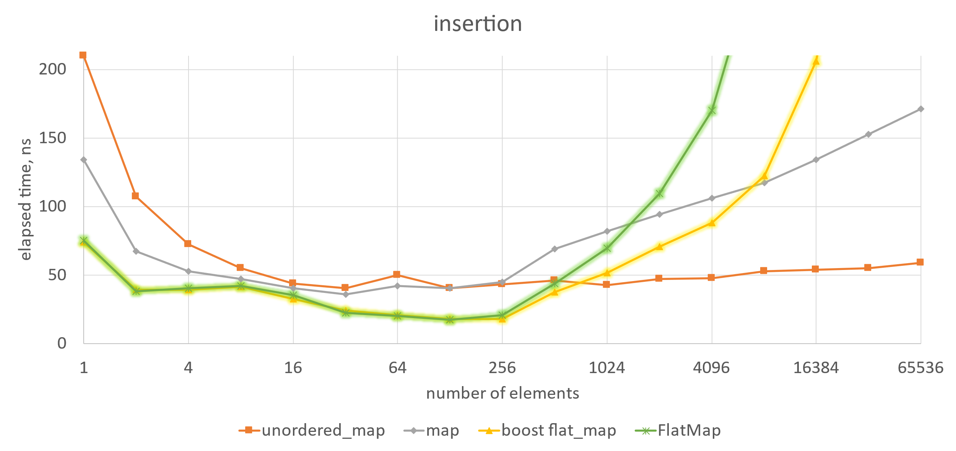
Benchmarking
boost flat_map and FlatMap are the fastest for small N

Slide 54
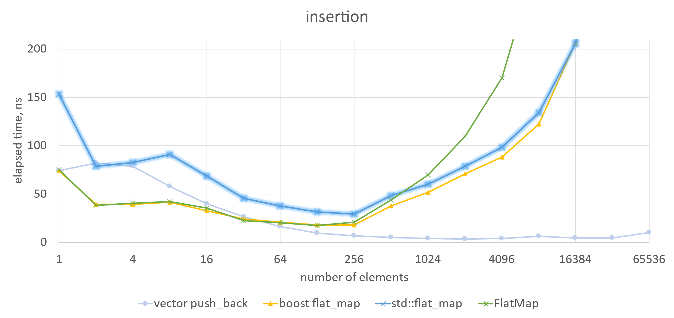
Benchmarking
std::flat_map is ⁓twice as slow for small N
due to double the amount of allocations

Slide 55
Benchmarking
namespace std {
template<
class Key,
class T,
class Compare = less<Key>,
class KeyContainer = vector<Key>,
class MappedContainer = vector<T>>
class flat_map;
}
also it is
not composable

Slide 56
namespace std {
template <class Key, class T, class Compare = less<Key>,
class KeyContainer = vector<Key>,
class MappedContainer = vector<T>>
class flat_map {
//...
using key_container_type = KeyContainer;
using mapped_container_type = MappedContainer;
//...
struct containers {
key_container_type keys;
mapped_container_type values;
};
//...
private:
containers c; // exposition only
};
}

Slide 57
When to use flat map?
Flat maps should be used:
for small constant maximum number of elements (known at compile time) e.g. for maximum number of elements = 30?
Flat maps may be used:
to do mostly lookups if std::unordered_map is unavailable to use e.g. initialization at once, and then only doing lookups
to do mostly iterations in order e.g. rare lookups/insertions/erasures, frequent iterations

Slide 58
When to use flat map?
Universal advice:
measure
measure
measure

Slide 59
My favourite feature of flat maps
auto map = boost::container::flat_map<int, int>{};
//...
auto items = map.extract_sequence();

Slide 60
My favourite feature of flat maps
auto map = boost::container::flat_map<int, int>{};
//...
boost::container::vector<std::pair<int, int>> items =
map.extract_sequence();
boost::container::vector<
std::pair<int, int>,
boost::container::new_allocator<std::pair<int, int>>>
items = map.extract_sequence();

Slide 61
My favourite feature of flat maps
using BoostFlatMap = boost::container::flat_map<int, int,
std::less<int>,
std::vector<std::pair<int, int>>>;
auto map = BoostFlatMap{};
//...
std::vector<std::pair<int, int>> items =
map.extract_sequence();

Slide 62
My favourite feature of flat maps
using BoostFlatMap = boost::container::flat_map<int, int,
std::less<int>,
std::vector<std::pair<int, int>>>;
std::vector<std::pair<int, int>> items;
//...
auto map = BoostFlatMap{};
map.adopt_sequence(std::move(items));

Slide 63
My favourite feature of flat maps
using BoostFlatMap = boost::container::flat_map<int, int,
std::less<int>,
std::vector<std::pair<int, int>>>;
auto map = BoostFlatMap{};
//...
auto items = map.extract_sequence();
//...
map.adopt_sequence(std::move(items));

Slide 64
My favourite feature of flat maps
using BoostFlatMap = boost::container::flat_map<int, int,
std::less<int>,
std::vector<std::pair<int, int>>>;
auto map = BoostFlatMap{};
//...
auto items = map.extract_sequence();
//...
map.adopt_sequence(boost::container::ordered_unique_range,
std::move(items));

Slide 65
My favourite feature of flat maps
template<typename Key,
typename Value,
typename Compare,
typename Container>
class FlatMap : private Compare {
//...
container_type extract() {
return std::move(container);
}
//...

Slide 66
template<typename Key,
typename Value,
typename Compare,
typename Container>
class FlatMap : private Compare {
//...
FlatMap(container_type &&c) : container{ std::move(c) } {
std::sort(container.begin(), container.end(),
makePredicate());
auto end = std::unique(container.begin(), container.end(),
makeEqualToPredicate());
container.erase(end, container.end());
}
//...

Slide 67
My favourite feature of flat maps
auto makeEqualToPredicate() {
struct EqualTo {
auto operator()(const typename Container::value_type &a,
const typename Container::value_type &b) const {
const auto &k1 = a.first;
const auto &k2 = b.first;
return !(comp(k1, k2) || comp(k2, k1));
}
const Compare &comp;
};
return EqualTo{ *static_cast<Compare *>(this) };
}

Slide 68
My favourite feature of flat maps
template<typename Key,
typename Value,
typename Compare,
typename Container>
class FlatMap : private Compare {
//...
FlatMap(SortedUnique_t, container_type &&c) :
container{ std::move(c) }
{}
//...
struct SortedUnique_t {} inline constexpr SortedUnique;

Slide 69
My favourite feature of flat maps
auto map = FlatMap<int, int>{};
//...
std::vector<std::pair<int, int>> items = map.extract();
//...
map = { std::move(items) };

Slide 70
My favourite feature of flat maps
auto map = FlatMap<int, int>{};
//...
auto items = map.extract();
//...
map = { std::move(items) };

Slide 71
My favourite feature of flat maps
auto map = FlatMap<int, int>{};
//...
auto items = map.extract();
//...
map = { SortedUnique, std::move(items) };

Slide 72
My favourite feature of flat maps
auto map = std::flat_map<int, int>{};
//...
std::flat_map<int, int>::containers items =
std::move(map).extract();
struct containers {
key_container_type keys;
mapped_container_type values;
};

Slide 73
My favourite feature of flat maps
auto map = std::flat_map<int, int>{};
//...
auto containers = std::move(map).extract();
must be moved

Slide 74
My favourite feature of flat maps
auto map = std::flat_map<int, int>{};
//...
auto [keys, values] = std::move(map).extract();
//...
map = { std::move(keys), std::move(values) };

Slide 75
My favourite feature of flat maps
auto map = std::flat_map<int, int>{};
//...
auto [keys, values] = std::move(map).extract();
//...
map = { std::sorted_unique,
std::move(keys), std::move(values) };

Slide 76
My favourite feature of flat maps
auto map = std::flat_map<int, int>{};
//...
auto [keys, values] = std::move(map).extract();
//...
// 'keys' should be sorted and contain unique elements
map.replace(std::move(keys), std::move(values));

Slide 77
What else could we do?
using BoostFlatMap = boost::container::flat_map<
int, int,
std::less<int>,
std::vector<std::tuple<int, int>>>;
v.first
v.second
not provided by std::tuple

Slide 78
What else could we do?
FlatMap<int, int,
std::less<int>,
std::vector<std::tuple<int, int>>
> map;
v.first std::get<0>(v)
v.second std::get<1>(v)

Slide 79
mapped_type &operator[](const Key &key) {
const auto predicate = makePredicate();
const auto needle = findNeedle(key, predicate);
// key < *needle
if (needle == container.end() or predicate(key, *needle))
return std::get<1>(
*container.emplace(needle,
std::piecewise_construct,
std::forward_as_tuple(key),
std::tuple<>())
);
return std::get<1>(*needle);
}
no piecewise constructor in std::tuple

Slide 80
mapped_type &operator[](const Key &key) {
const auto predicate = makePredicate();
const auto needle = findNeedle(key, predicate);
// key < *needle
if (needle == container.end() or predicate(key, *needle))
return std::get<1>(
*container.emplace(needle,
key,
Value{})
);
return std::get<1>(*needle);
}
unwanted temporary object and move/copy

Slide 81
What else could we do?
template<
typename Key,
typename Value,
typename Compare = std::less<Key>,
typename Container = std::vector<std::pair<Key, Value>>,
auto KeyGetter = [](auto &v)->decltype(auto) {
return std::get<0>(v); },
auto ValueGetter = [](auto &v)->decltype(auto) {
return std::get<1>(v); }
>
class FlatMap;

Slide 82
What else could we do?
struct MyStruct {
int key;
int value;
};
FlatMap<int, int,
std::less<int>,
std::vector<MyStruct>,
[](auto &v)->decltype(auto) { return (v.key); },
[](auto &v)->decltype(auto) { return (v.value); }
> map;

Slide 83
Possible future work
extend flat map to be able to use tuples
and arbitrary types
add policy choice between single container and separate containers for keys and values
or rather make a separate type, e.g. like zip_flat_map?
or have flat_map and provide zip_sequence adaptor?

Slide 84
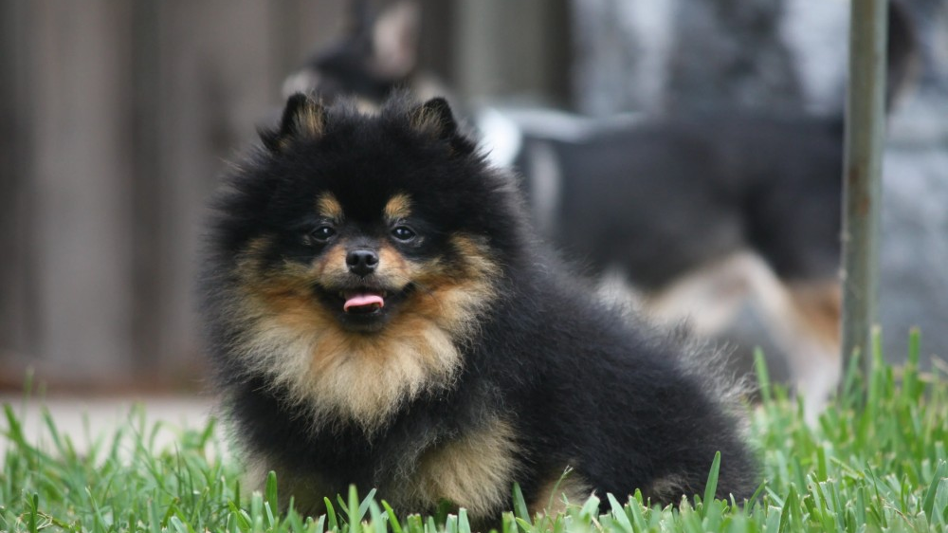
Thanks for listening!

Slide 85

flat_map Who needs them? They're just like `std::map`. We all have them.
Pavel Novikov
@cpp_ape
Thanks to Zach Laine.
Slides: bit.ly/3UY92Az

Slide 86
References
P0429: A Standard flat_map https://wg21.link/P0429
std::flat_map proof of concept implementation by Zach Laine https://github.com/tzlaine/flat_map

Slide 87
Bonus slides

Slide 88
template<typename K, typename V, typename I>
struct Iterator {
explicit Iterator(I i) : i{ std::move(i) } {}
Iterator &operator++() { ++i; return *this; }
std::pair<K&, V&> operator*() const { return { i->first, i->second }; }
auto operator->() const {
//...
}
friend auto operator<=>(const Iterator&, const Iterator&) = default;
private:
I i;
template<typename, typename, typename, typename> friend class FlatMap;
};

Slide 89
iterator operator->
template<typename K, typename V, typename I>
struct Iterator {
//...
auto operator->() const {
struct Helper {
std::pair<K&, V&> ref;
auto operator->() const { return &ref; }
};
return Helper{ **this };
}
//...
};
map.begin()->second

Slide 90
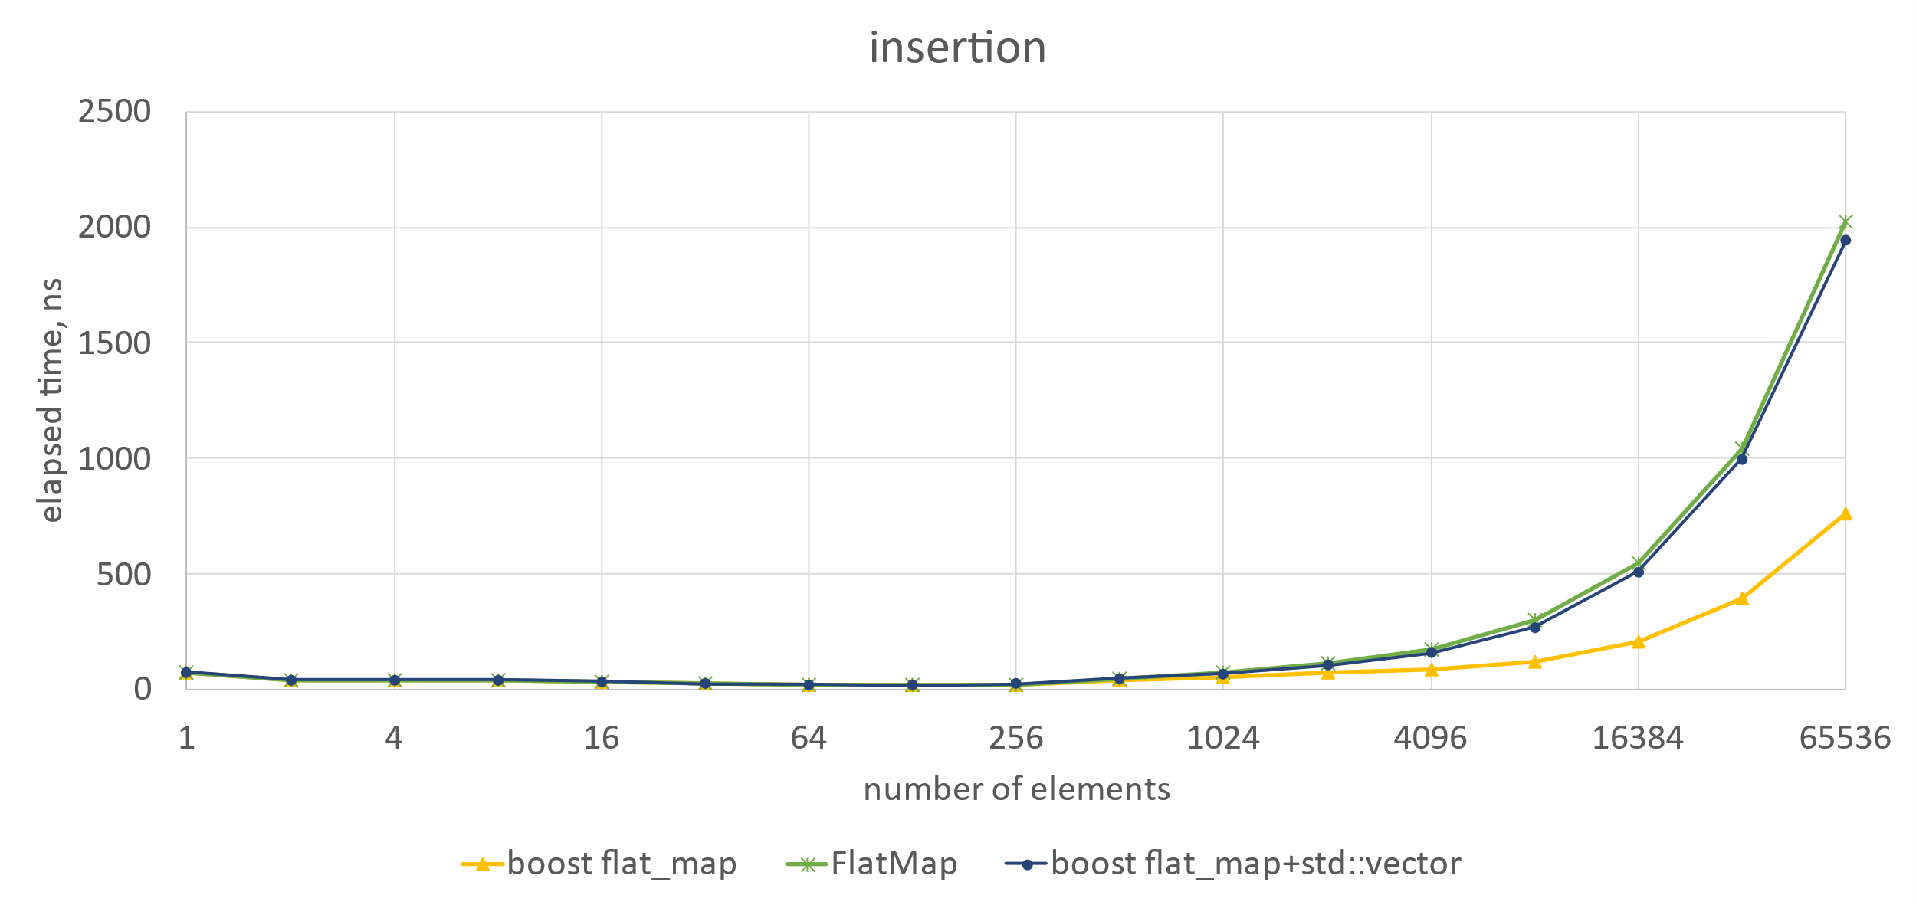
boost flat_map + std::vector

Slide 91
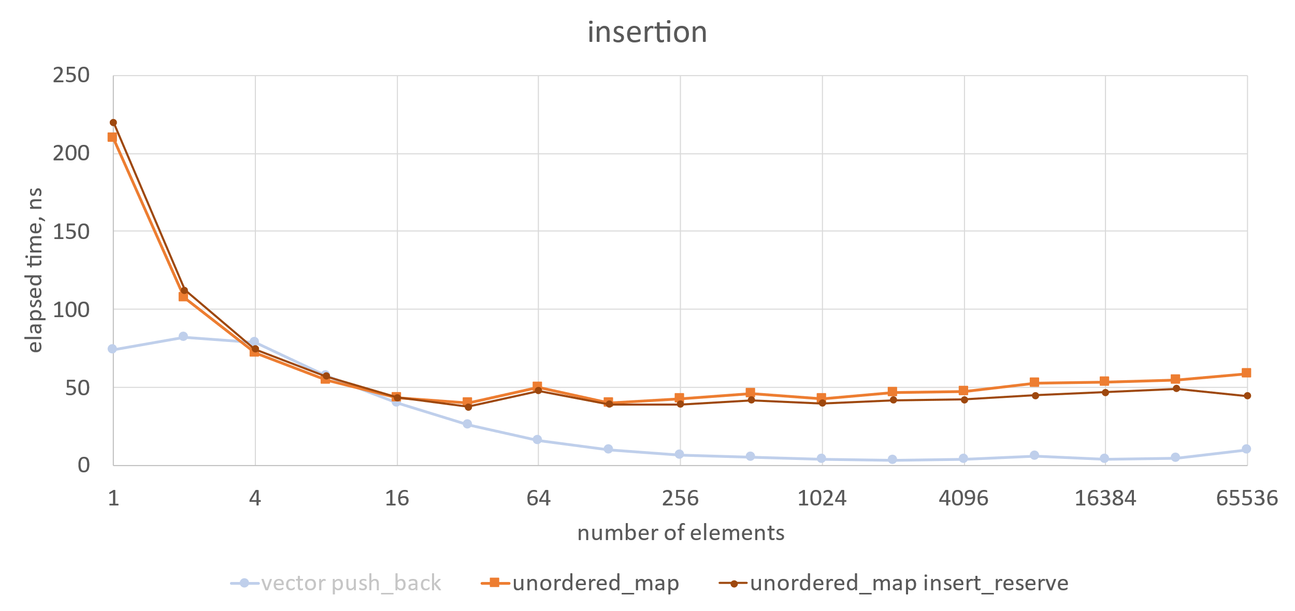
effect of reserve

Slide 92
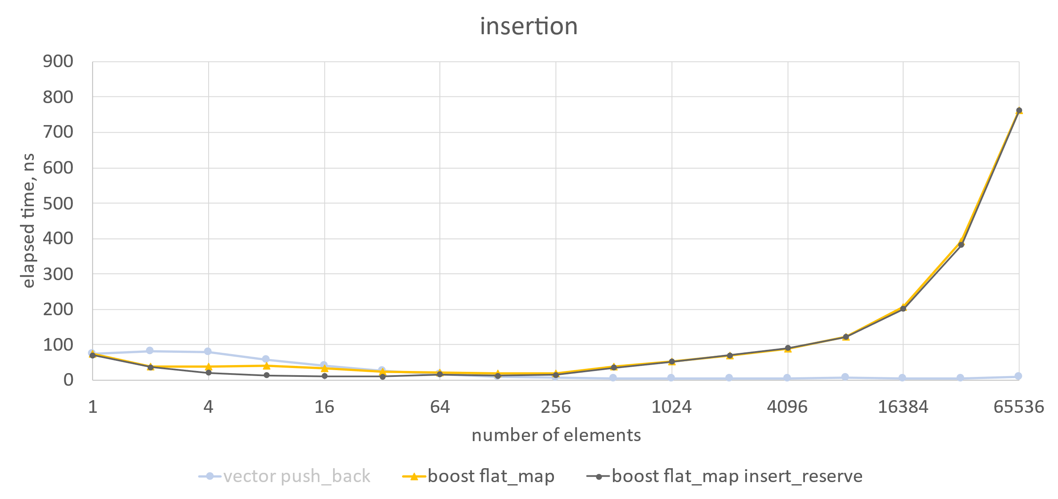
effect of reserve

Slide 93
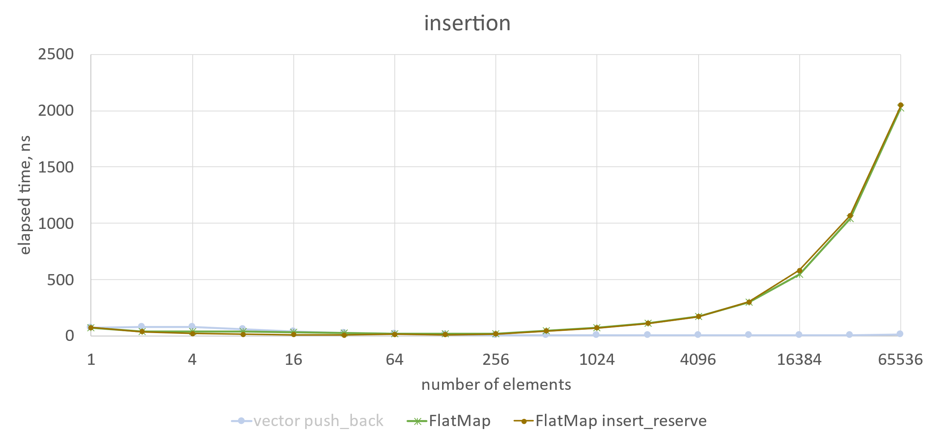
effect of reserve

